Slide 1
A First Book of ANSI C Fourth Edition
Chapter 7
Modularity Using Functions: Part II

Slide 2
Objectives
Variable Scope
Variable Storage Class
Pass by Reference
Case Study: Swapping Values
Recursion
Common Programming and Compiler Errors

Slide 3
Variable Scope
If variables created inside a function are available only to the function itself, they are said to be local to the function, or local variables
Scope is the section of the program where the variable is valid or “known”

Slide 4
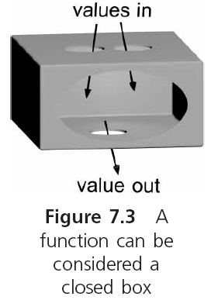
Variable Scope (continued)

Slide 5
Variable Scope (continued)
A variable with a local scope has had storage set aside for it by a declaration statement made within a function body
A variable with global scope is one whose storage has been created for it by a declaration statement located outside any function

Slide 6
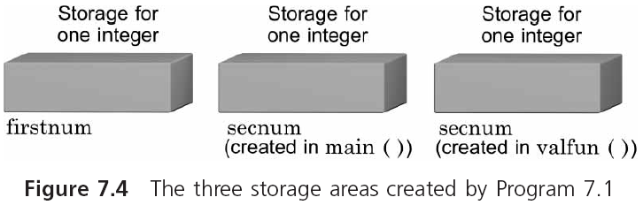
Variable Scope (continued)

Slide 7
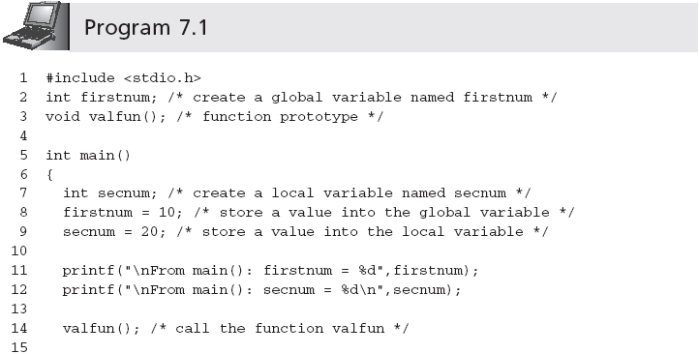
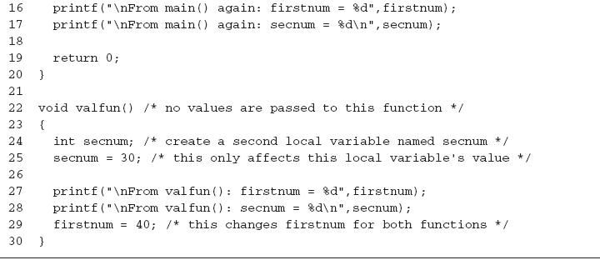
Variable Scope (continued)

Slide 8
Variable Scope (continued)
Program 7.1 produces the following output
From main(): firstnum = 10
From main(): secnum = 20
From valfun(): firstnum = 10
From valfun(): secnum = 30
From main() again: firstnum = 40
From main() again: secnum = 20
While a function is executing, only the storage area for the variables and parameters created by this function are automatically accessed

Slide 9
Variable Scope (continued)
If a variable that is not local to the function is used by the function, the program searches the global storage areas for the correct name
The scope of a variable does not influence the data type of the variable

Slide 10
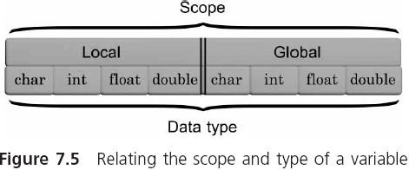
Variable Scope (continued)

Slide 11
When to Use Global Declarations
The scoping rules for symbolic constants and function prototypes are the same as for variables
When a symbolic constant has a general meaning that is applicable throughout an application, it makes good programming sense to declare it globally at the top of a source code file
Coding a function prototype as a global makes sense when the function is used by a number of other functions in a source code file
Doing so avoids repeating the prototype within each of the functions that will call it

Slide 12
Misuse of Global Variables
Except for symbolic constants and prototypes, global variables should almost never be used
By making a variable global, you instantly destroy the safeguards C provides to make functions independent and insulated from each other
Using global variables can be especially disastrous in large programs with many user-created functions
Because a global variable can be accessed and changed by any function following the global declaration, it is a time-consuming and frustrating task to locate the origin of an erroneous value

Slide 13
Variable Storage Class
In addition to the space dimension represented by its scope, variables also have a time dimension
Called the variable’s “lifetime”
Where and how long a variable’s storage locations are kept before they are released can be determined by the storage class of the variable
auto, static, extern, and register

Slide 14
Variable Storage Class (continued)
Examples:
auto int num;
static int miles;
extern int price;
register int dist;
auto float coupon;
static float yrs;
extern float yld;
auto char inKey;

Slide 15
Local Variable Storage Classes
Local variables can only be members of the auto, static, or register storage classes
auto is the default class used by C
The term auto is short for automatic
Storage for automatic local variables is automatically reserved each time a function declaring automatic variables is called
As long as the function has not returned control to its calling function, all automatic variables local to the function are “alive”; that is, storage for the variables is available

Slide 16
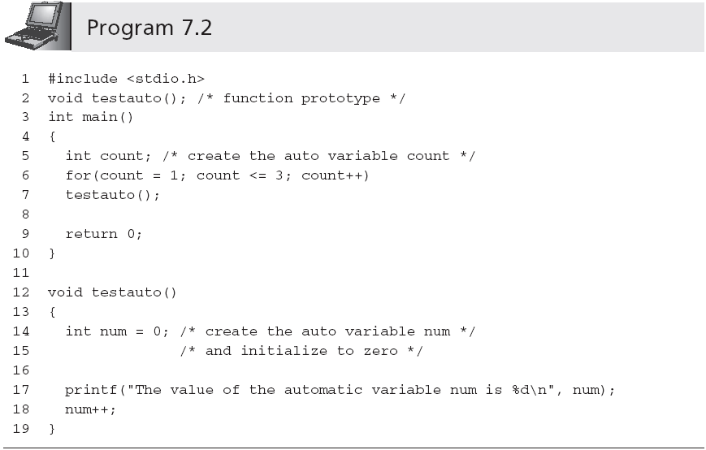
Local Variable Storage Classes (continued)
Output is:
The value of the automatic variable num is 0
The value of the automatic variable num is 0
The value of the automatic variable num is 0

Slide 17
Local Variable Storage Classes (continued)
A local variable declared as static causes the program to keep the variable and its value even when the function that declared it is done
Once created, local static variables remain in existence for the life of the program
Static variables are not initialized at run-time
The initialization of static variables is done only once, when the program is first compiled
Some compilers initialize local static variables the first time the definition statement is executed rather than when the program is compiled

Slide 18
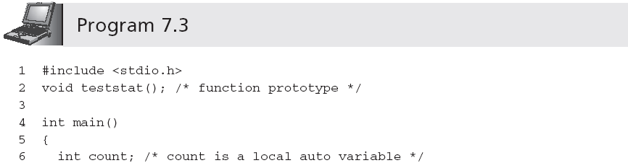
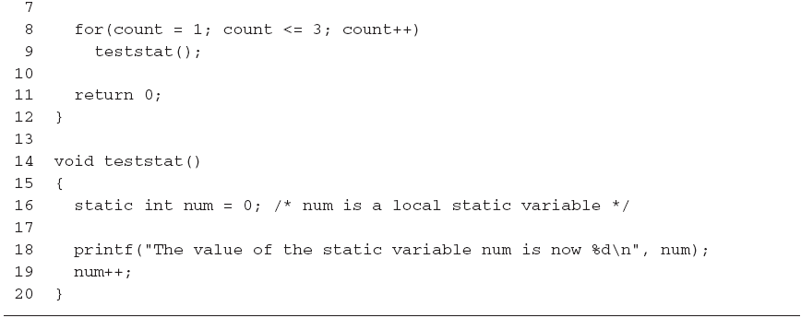
Local Variable Storage Classes (continued)
Output is:
The value of the static variable num is now 0
The value of the static variable num is now 1
The value of the static variable num is now 2

Slide 19
Local Variable Storage Classes (continued)
Register variables have the same time duration as automatic variables
register int time;
Registers are high-speed storage areas physically located in the computer’s processing unit
Application programs rarely, if ever, should use register variables
Variables declared with the register storage class are automatically switched to auto if the compiler does not support register variables or if the declared register variables exceed the computer’s register capacity

Slide 20
Global Variable Storage Classes
Global variables are created by declaration statements external to a function
They exist until the program in which they are declared is finished executing
Global variables are declared static or extern
extern int sum;
static float yield;
The purpose of the extern storage class is to extend the scope of a global variable declared in one source code file into another source code file

Slide 21
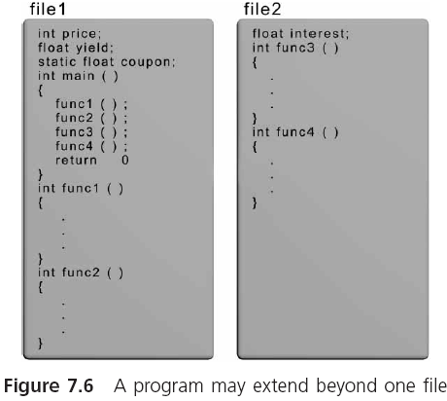
Global Variable Storage Classes (continued)

Slide 22
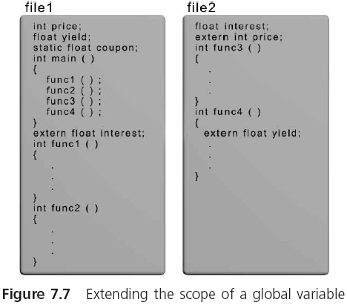
Global Variable Storage Classes (continued)

Slide 23
Global Variable Storage Classes (continued)
Declaration statements containing the word extern do not create new storage areas; they only extend the scope of existing global variables
The static global class is used to prevent the extension of a global variable into a second file
The scope of a global static variable cannot be extended beyond the file in which it is declared
Provides some privacy for static global variables

Slide 24
Pass by Reference
In pass by value, a called function receives values from its calling function, stores the passed values in its own local parameters, manipulates these parameters appropriately, and directly returns, at most, a single value
Passing an address is referred to as a function pass by reference, because the called function can reference, or access, the variable using the passed address
Also referred to as a call by reference when the term applies only to those parameters whose addresses have been passed

Slide 25
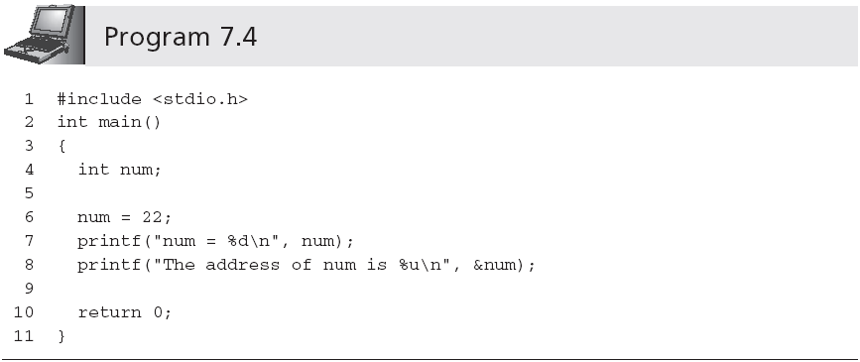
Passing Addresses to a Function
Output is:
num = 22
The address of num is 124484

Slide 26
Storing Addresses
numAddr = &num;
A variable that can store an address is known as a pointer variable or pointer

Slide 27
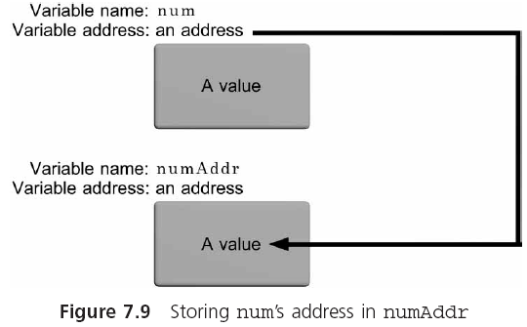
Storing Addresses (continued)

Slide 28
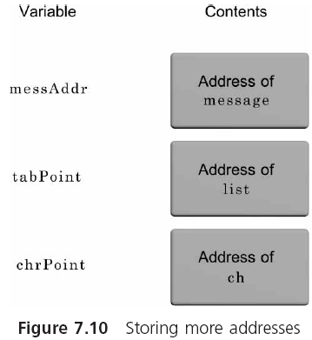
Storing Addresses (continued)

Slide 29
Using Addresses
Indirection operator: *
*numAddr means the variable whose address is stored in numAddr
Or, the variable pointed to by numAddr
When using a pointer, the value obtained is always found by first going to the pointer for an address; this is called indirect addressing

Slide 30
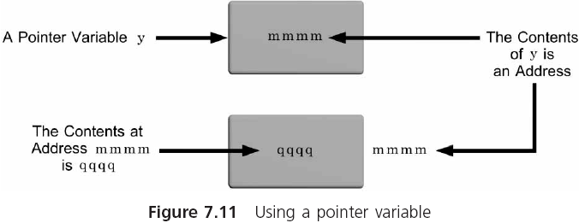
Using Addresses (continued)

Slide 31
Declaring and Using Pointers
In declaring a pointer variable, C requires that we also specify the type of variable that is pointed to
int *numAddr;
This declaration can be read in a number of ways: as the variable pointed to by numAddr is an integer, or as numAddr points to an integer

Slide 32
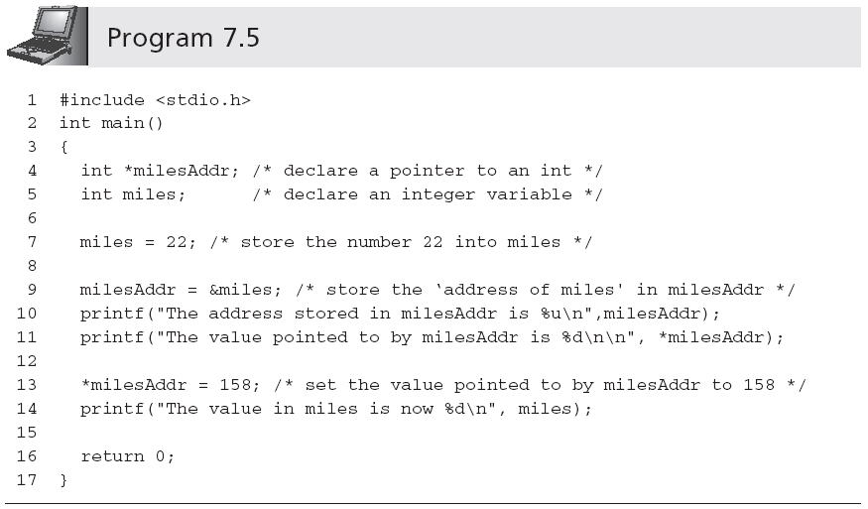
Declaring and Using Pointers (continued)
Output is:
The address stored in milesAddr is 1244872
The value pointed to by milesAddr is 22
The value in miles is now 158

Slide 33
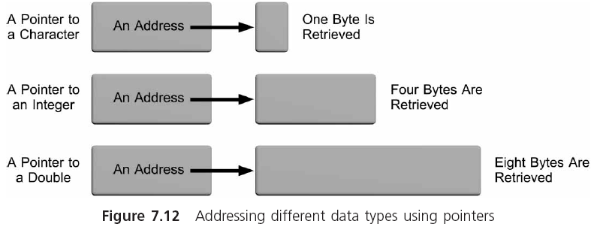
Declaring and Using Pointers (continued)

Slide 34
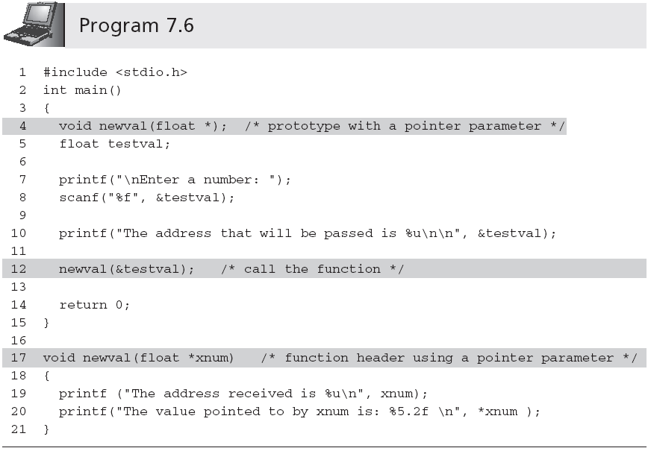
Passing Addresses to a Function

Slide 35
Passing Addresses to a Function (continued)
Sample run of Program 7.6:
Enter a number: 24.6
The address that will be passed is 124484
The address received is 124484
The value pointed to by xnum is: 24.60

Slide 36
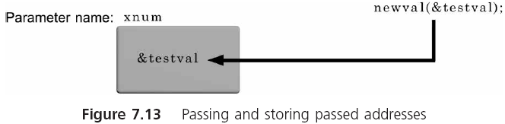
Passing Addresses to a Function (continued)

Slide 37
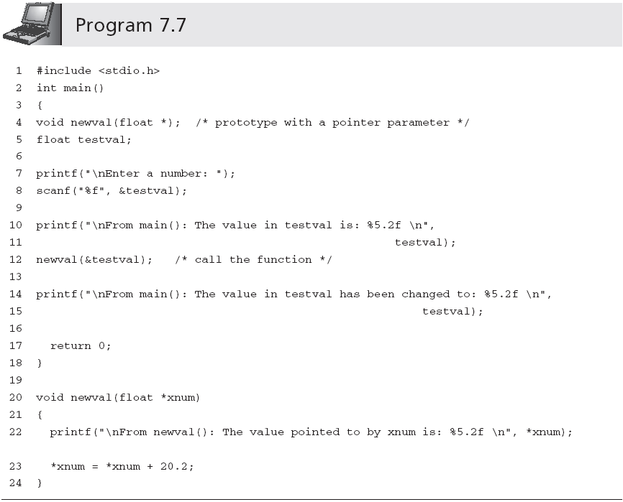
Passing Addresses to a Function (continued)
Add 20.2 to the value of the variable pointed to by xnum

Slide 38
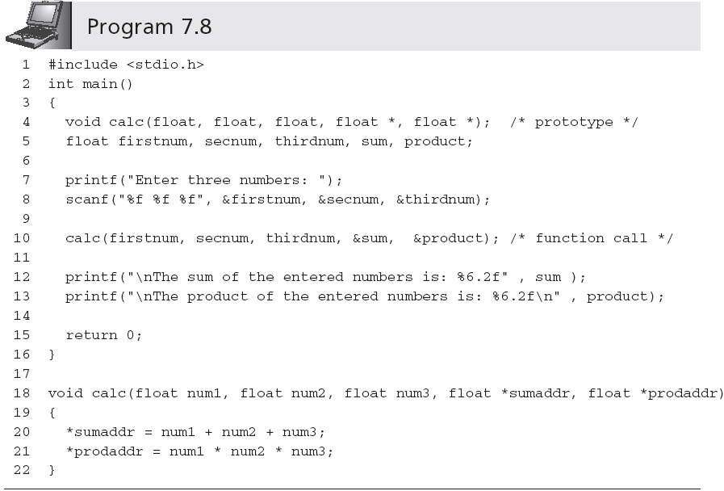
Passing Addresses to a Function (continued)
Returns multiple values

Slide 39
Case Study: Swapping Values
A common programming requirement is the sorting of both numeric values and text, such as names, in either ascending (increasing) or descending (decreasing) order
Typically accomplished by comparing two values and then switching values if they are not in the correct order

Slide 40
Requirements Specification
Write a C function that exchanges the values in two single-precision variables of its called function
Thus, if the function has access to two variables of its calling function, the called function should switch the values in these variables

Slide 41
Analyze the Problem
Input (arguments of the function): two addresses, of the two variables whose values are to be exchanged
Output: change the values in the calling function using passed addresses
Swapping the values of two variables is accomplished using the following algorithm:
Store the first variable’s value in a temporary location
Store the second variable’s value in the first variable
Store the temporary value in the second variable

Slide 42
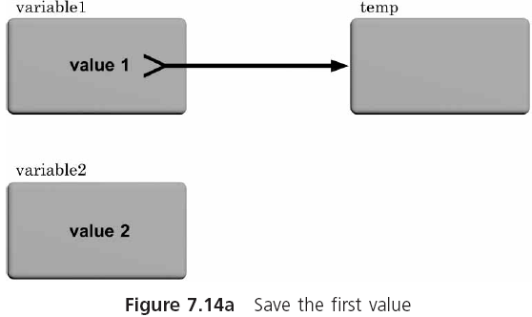
Analyze the Problem (continued)

Slide 43
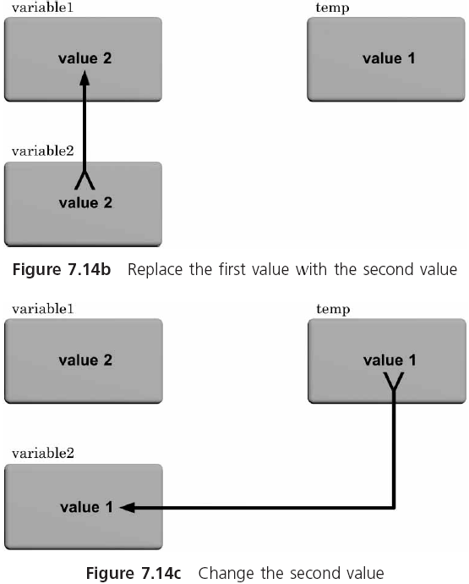
Analyze the Problem (continued)

Slide 44
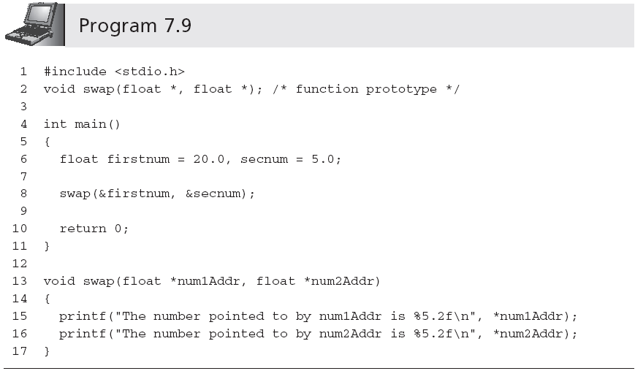
Code the Function

Slide 45
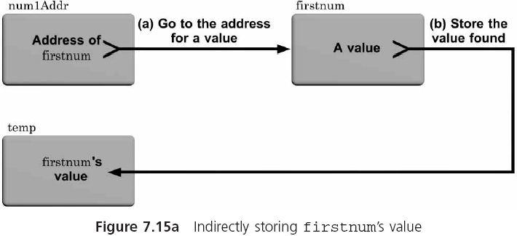
Code the Function (continued)

Slide 46
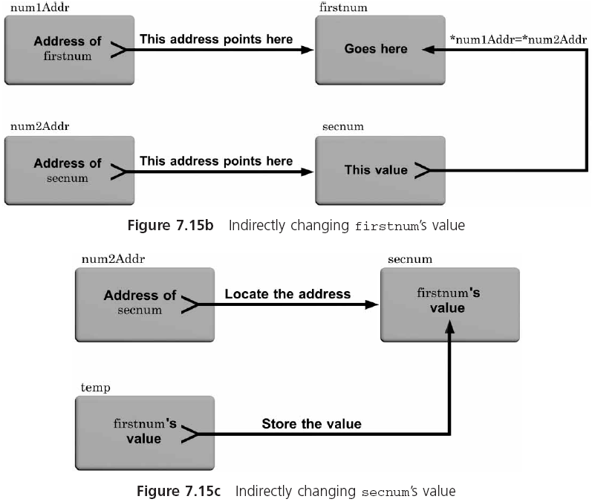
Code the Function (continued)

Slide 47
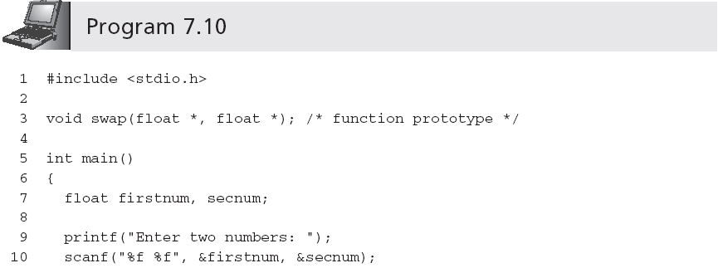
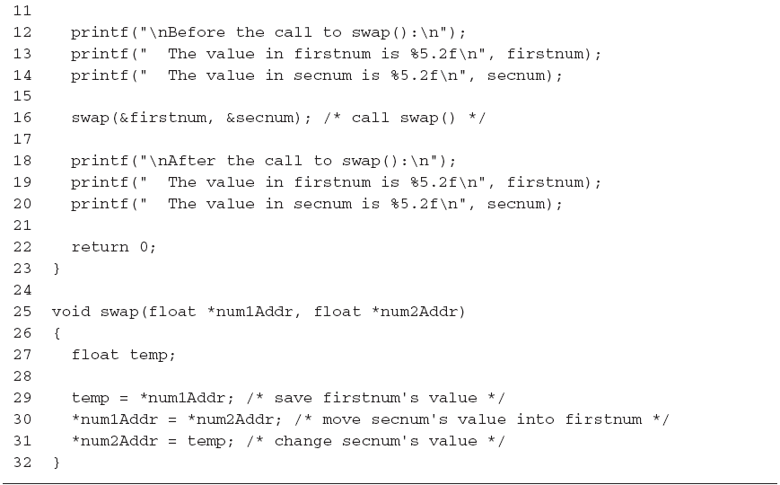
Code the Function (continued)

Slide 48
Test and Debug the Program
The following sample run was obtained using Program 7.10, which completes the verification:
Enter two numbers: 20.5 6.25
Before the call to swap():
The value in firstnum is 20.50
The value in secnum is 6.25
After the call to swap():
The value in firstnum is 6.25
The value in secnum is 20.50

Slide 49
Recursion
Functions that call themselves are referred to as self-referential or recursive functions
When a function invokes itself, the process is called direct recursion
A function can invoke a second function, which in turn invokes the first function; this type of recursion is referred to as indirect or mutual recursion

Slide 50
Mathematical Recursion
The definition for n! can be summarized by the following statements:
0! = 1
n! = n * (n-1)! for n >= 1
This definition illustrates the general considerations that must be specified in constructing a recursive algorithm:
What is the first case or cases?
How is the nth case related to the (n-1) case?

Slide 51
Mathematical Recursion (continued)
In pseudocode, the processing required is
If n = 0
factorial = 1
Else
Factorial = n * factorial(n - 1)
In C, this can be written as
int factorial(int n)
{
if (n == 0)
return (1);
else
return (n * factorial(n-1));
}

Slide 52
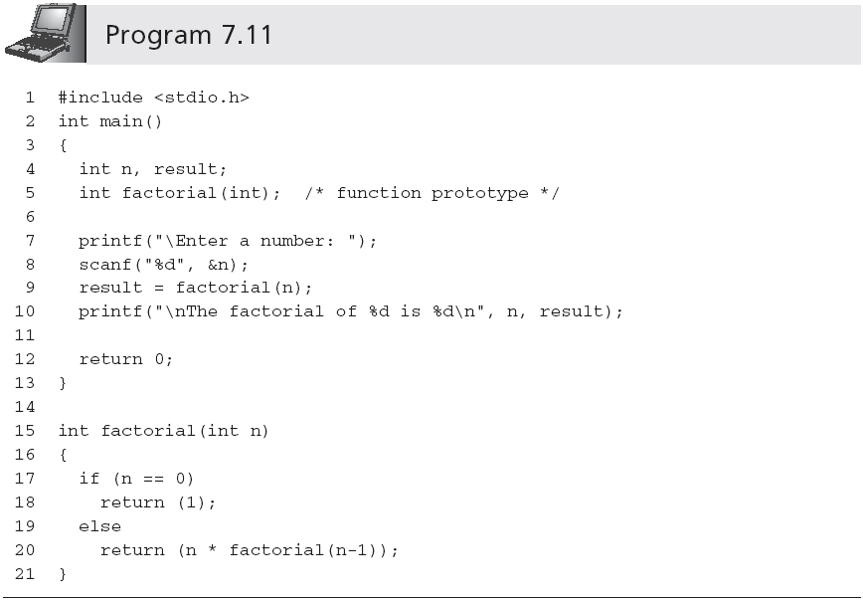
Mathematical Recursion (continued)

Slide 53
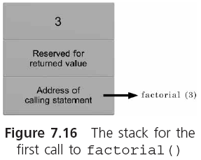
How the Computation is Performed

Slide 54
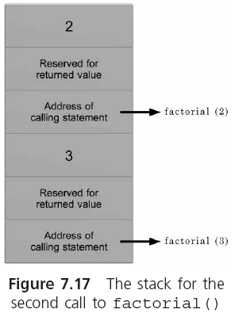
How the Computation is Performed (continued)

Slide 55
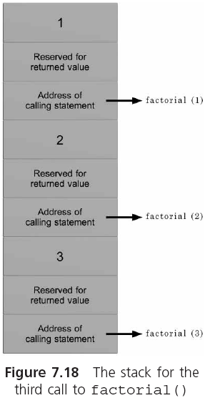
How the Computation is Performed (continued)

Slide 56
Recursion versus Iteration
The recursive method can be applied to any problem in which the solution is represented in terms of solutions to simpler versions of the same problem
Any recursive function can be written in a nonrecursive manner using an iterative solution
int factorial(int n)
{
int fact;
for(fact = 1; n > 0; n--)
fact = fact * n;
return (fact);
}

Slide 57
Common Programming Errors
Using the same name for a local variable that has been used for a global variable
Becoming confused about whether a parameter (or variable) contains an address or is an address
Declaring a pointer as a function parameter and then forgetting to place the address operator, &, before the argument passed to the function when it is called
Forgetting to specify the initial case when a recursive function is defined

Slide 58
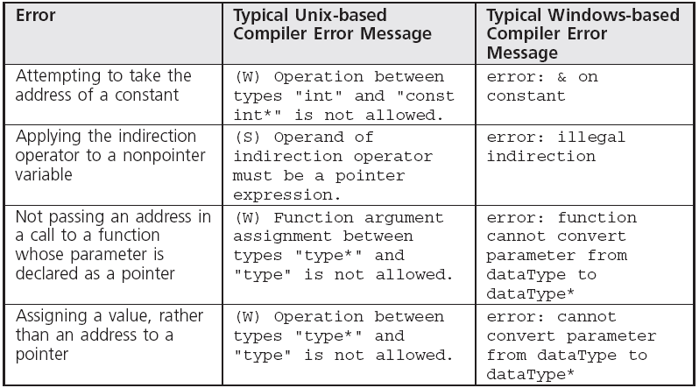
Common Compiler Errors

Slide 59
Summary
Every variable used in a program has scope, which determines where the variable can be used
Every variable has a class
Every variable has a data type, a value, and an address
A pointer is a variable or parameter that is used to store the address of another variable
If a parameter or variable is a pointer, then the indirection operator, *, must be used to access the variable whose address is stored in the pointer

Slide 60
Summary (continued)
The address of a variable can be passed to a function
When a called function receives an address, it has the capability of directly accessing the respective calling function’s variable
A recursive solution is one in which the solution can be expressed in terms of a “simpler” version of itself
If a problem solution can be expressed repetitively or recursively with equal ease, the repetitive solution is preferable because it executes faster and uses less memory

